Slide 1
Experimental Solid Rocket Nozzle
By: Cameron Flannery, Harrison Box

Slide 2
Agenda
Vehicle Overview
Nozzle Design Overview
Dimensions
Thermal
Fluid Flow
Risks

Slide 3
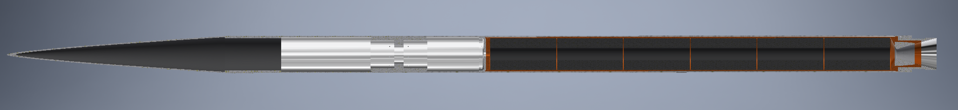
Vehicle Overview (Major Components)
17’
7’8”
Nosecone
Recovery System
6 BATES grains
Avi-bay
Section Adapter
Ablative Nozzle
General
2 piece aluminum airframe
Aluminum section adapter
¾ power series nosecone
Carbon fiber
Note: Fins still under design review
Propulsion
Q-Class Motor
APCP (Aluminum Fuel/Ammonium Perchlorate Oxidizer)
Ablatively cooled nozzle
BATES grains

Slide 4
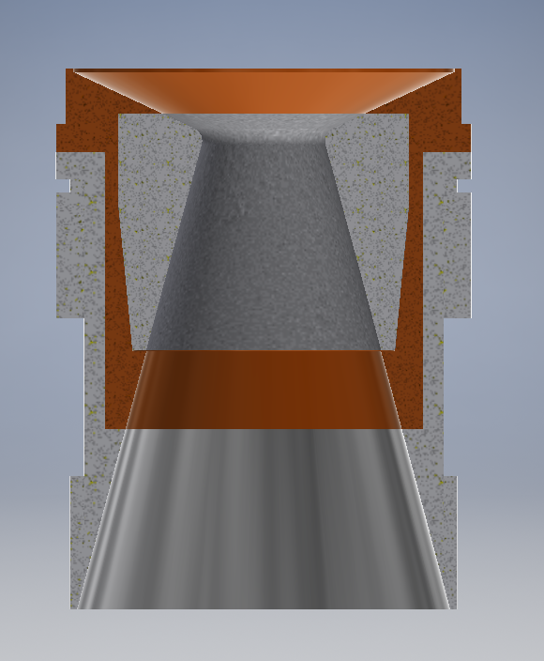
Nozzle Overview
Phenolic
(2-pieces)
Graphite Throat
Aluminum Retainer
Aluminum Carrier
Aluminum Skirt

Slide 5
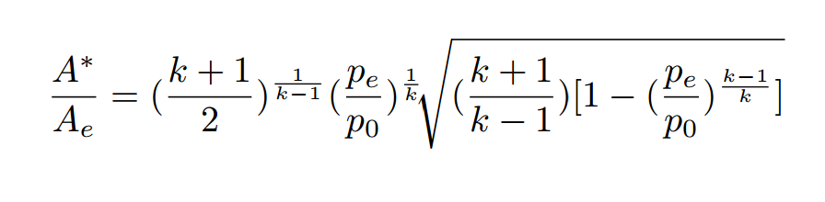
Dimensioning
2.30”
Calculating Optimal Expansion Ratio*:
Ideal**: 2.4 – calculated with combustion products properties
Actual: 2.934
Under-expansion results from manufacturing capabilities.
Exact impact on performance is difficult to calculate due to liquid combustion products (Al)
Performance decrease of ~5% expected
6.75”
*equation from Rocket Propulsion Elements
** at sea-level

Slide 6
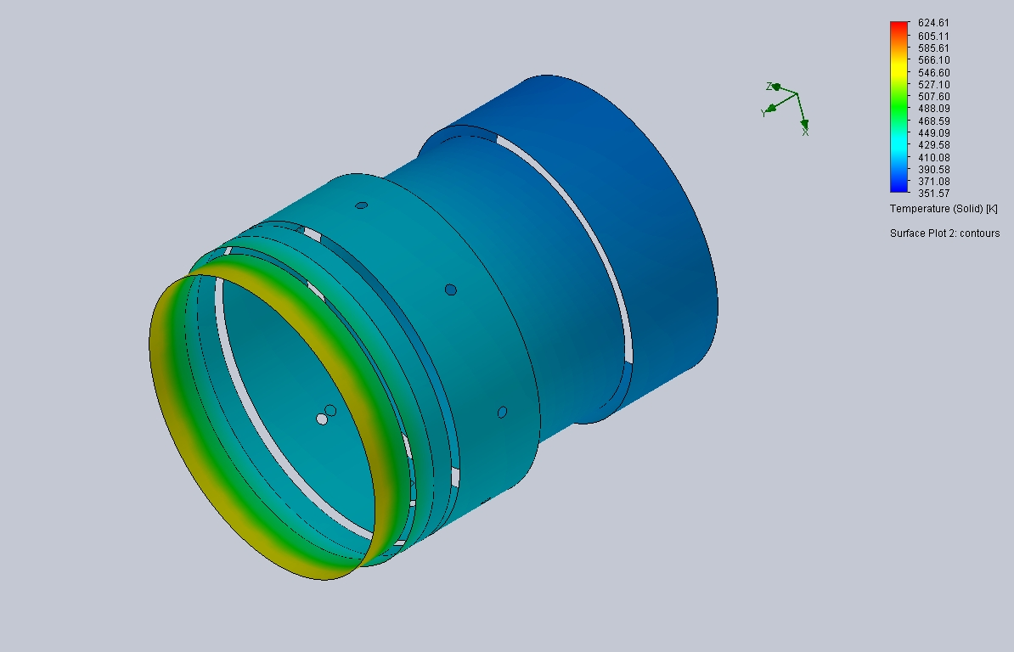

Nozzle Design – Stresses
Material Properties:
Phenolic Liner: Liner thickness; ¼”
Heat Transfer Through Phenolic Liner: $0.15\frac{W}{m∗K}$
Nozzle Al reaches max(T) ~ 580 K
1” of Al material thickness at hottest point
Yield Strength: 35,000 psi
Max Hoop Stress: 2,437 psi
F.S. > 14

Slide 7
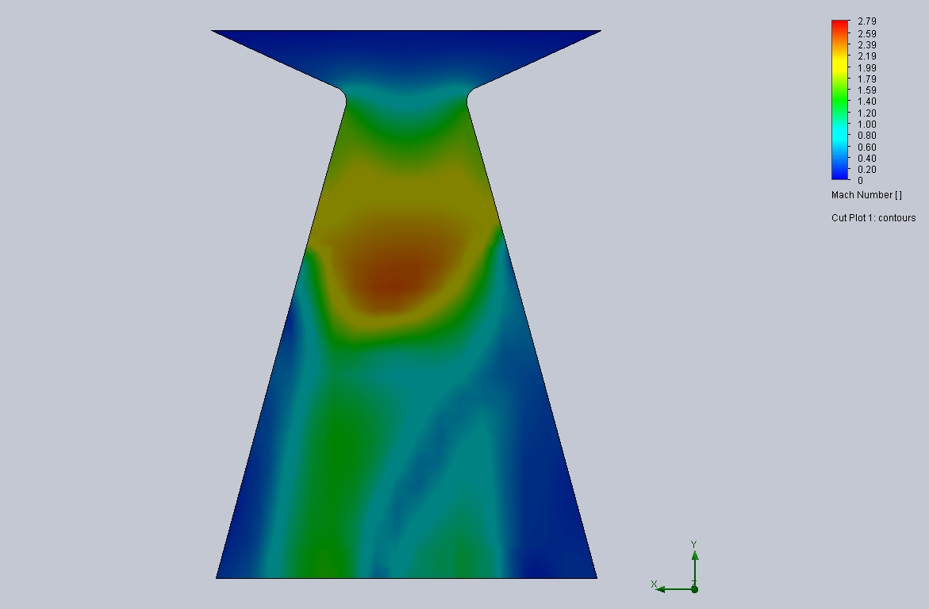
Nozzle Design – Fluid Flow
Aim:
Prevent cavitation
Prevent separation of flow
Analysis:
CFD Analysis
Assumes gaseous combustion products
Results in approximately 10% error due to aluminum in propellant

Slide 8
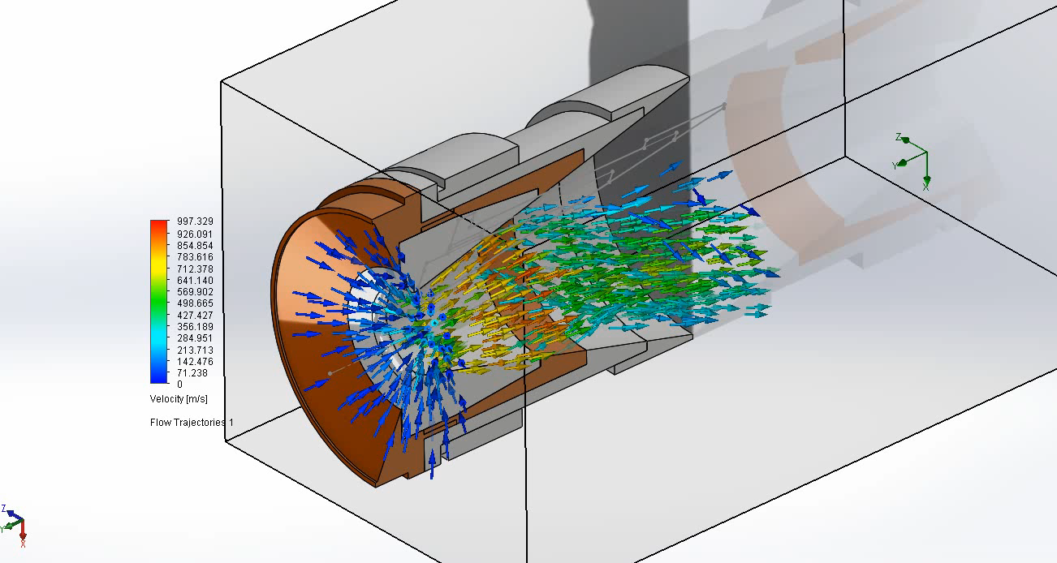
Nozzle Design – Fluid Analysis

Slide 9
Design for Manufacturability
6061 Series Aluminum
Phenolic and graphite relatively simple to machine
Cone Nozzle:
Easy to machine with a lathe
No crazy contours
Drawings created with GD&T for each part

Slide 10
Risks & Issues
Over-expansion is not quantified
Solution: is to perform a static fires at sea-level with different expansion ratios
Cavitation and Separation of Flow
Phenolic Thermal Barrier
Melting point below temp of chamber
Solution: replace phenolic with carbon at nozzle entry

Slide 11
Q & A

